Slide 1
WSQ COURSE • TGS-2025052468
Version 22.0 · 29 Oct 2026
Agentic AI Applications
with Claude Code
Tertiary Infotech Academy Pte Ltd
UEN: 201200696W
www.tertiarycourses.com.sg | enquiry@tertiaryinfotech.com | +65 6100 0613
© Tertiary Infotech Academy Pte Ltd

Slide 2

HOUSEKEEPING
Digital Attendance
Attendance is mandatory for SSG funding.
Take AM, PM and Assessment digital attendance for every session.
Use the SSG / TMS QR code provided by your trainer.
Minimum
75%
attendance required
© Tertiary Infotech Academy Pte Ltd
Agentic AI Applications with Claude Code
2

Slide 3





INTRODUCTION
About the Trainer
Qualifications: ____________________________________________
Expertise: _________________________________________________
[ Trainer Name ]
[ Title / Role ]
Experience: ________________________________________________
Contact / Profile: __________________________________________
© Tertiary Infotech Academy Pte Ltd
Agentic AI Applications with Claude Code
3

Slide 4




INTRODUCTION
About the Trainer
PhD-qualified trainer specialising in AI, software engineering and developer tooling.
Hands-on experience building agentic AI applications with Claude Code.
Dr. Alfred Ang
AI Trainer & Engineer
Trains professionals across Singapore on practical, project-based AI skills.
Certifications: Claude Certified Associate (Foundations),
PMP, AWS, Microsoft, CompTIA, CKA, CKAD.
linkedin.com/in/angchewhoe
github.com/alfredang
© Tertiary Infotech Academy Pte Ltd
Agentic AI Applications with Claude Code
4

Slide 5




INTRODUCTION
Let's Know Each Other
Take a minute to introduce yourself to the class:
Your name & role
What you do day to day
Your coding experience
What you want from this course
© Tertiary Infotech Academy Pte Ltd
Agentic AI Applications with Claude Code
5

Slide 6






HOUSEKEEPING
Ground Rules
Phones on silent
Participate actively
Mutual respect
Step out quietly for calls or breaks.
No question is stupid — ask freely.
Agree to disagree; one conversation at a time.
Be punctual
75% attendance
Stay hands-on
Return from breaks on time.
Required for funding eligibility.
Follow along with every activity.
© Tertiary Infotech Academy Pte Ltd
Agentic AI Applications with Claude Code
6

Slide 7
ROADMAP
Course Outline
1
2
3
Claude Code Fundamentals
Tools and Commands
Skills, Agents & Hooks
Setup & the Agentic Loop
Context, Memory & Sessions
Permissions & Scheduled Tasks
Activity: Build & deploy a website
Custom Commands
MCP Tools
Playwright MCP
Activities: /gitpush + MCP screenshot
Agent Skills
Sub Agents
Hooks
Key Concepts Summary
© Tertiary Infotech Academy Pte Ltd
Agentic AI Applications with Claude Code
7

Slide 8
ROADMAP · HANDS-ON
Lab Materials
Four labs, each in its own folder. They build on one another — Lab 1 creates the website that every later lab extends.
Lab 1
The 7-step build workflow — goal, plan, execute, /init, GitHub, Pages, CI/CD.
Topic 1
labs/lab1-seven-steps/
Lab 1b
A /publish custom command + Playwright MCP screenshots into the README.
Topic 2
labs/lab1b-commands-mcp/
Lab 2
Install 3 skills — cybersecurity, kanban, UI/UX — and revamp the site.
Topic 3
labs/lab2-skills/
Lab 3
Hooks, sub agents and /loop — the event, delegation and schedule triggers.
Topic 3
labs/lab3-hooks/
TIP Every step gives you the exact prompt to paste, what you should see, and a checkpoint before moving on.
© Tertiary Infotech Academy Pte Ltd
Agentic AI Applications with Claude Code
8

Slide 9
ROADMAP
Lesson Plan (9:00 AM – 6:00 PM)
Time | Session
9:00 – 9:30 | Welcome, admin, attendance (AM), introductions, ground rules
9:30 – 10:30 | Topic 1.1: agentic loop & tools, setup, permission modes
10:30 – 10:40 | Morning break
10:40 – 11:20 | Topic 1.2: context, memory, sessions, scheduled tasks, /goal
11:20 – 12:30 | Activity 1: Build & deploy a website
12:30 – 1:15 | Lunch break
1:15 – 1:45 | Topic 2: Custom commands · Activity 2: /gitpush
1:45 – 2:45 | Topic 2: MCP tools · Activity 3: Playwright screenshot + form test
2:45 – 2:55 | Afternoon break
2:55 – 3:40 | Topic 3: Agent skills · Activity 4: frontend-design & SEO
3:40 – 4:25 | Topic 3: Sub agents & hooks · Activity 5: security + UX agents
4:25 – 4:50 | Activities 6–7 · hooks, testing, optimisation & deployment
4:50 – 5:00 | Summary, Q&A, attendance (PM)
5:00 – 6:00 | Final Assessment: 30 min WA + 30 min PP (on the LMS)
© Tertiary Infotech Academy Pte Ltd
Agentic AI Applications with Claude Code
9

Slide 10





ASSESSMENT
Briefing for Assessment
Clear your space
No recording
Open book
Place phones and other materials under the table or on the floor.
No photos or recording of assessment materials.
Only slides, learner guide and approved materials are allowed.
Work individually
Manage your time
Appeals
Complete the assessment on your own; no discussion.
Written Assessment then Practical Performance — watch the clock.
An appeal process is available if you disagree with the outcome.
© Tertiary Infotech Academy Pte Ltd
Agentic AI Applications with Claude Code
10

Slide 11


ASSESSMENT
Assessment & Funding
Final Assessment
Criteria for Funding
Written Assessment (WA) — 30 min, starts 5:00 PM
Practical Performance (PP) — 30 min
Format: Open book — class ends 6:00 PM
Allowed: slides, learner guide & approved materials only
Appeal process available
Minimum 75% attendance
Based on SSG digital attendance records.
Assessed as ‘Competent’
Complete and pass both assessment components.
© Tertiary Infotech Academy Pte Ltd
Agentic AI Applications with Claude Code
11

Slide 12

COURSE PORTAL
Login to LMS and Download Course Material
Log in at lms-tms.tertiaryinfotech.com with your registered email and the OTP sent to your inbox, then open this course to download the slides and Learner Guide.
© Tertiary Infotech Academy Pte Ltd
12

Slide 13


LEARNING MANAGEMENT SYSTEM
Courseware & Assessment on the LMS
Download the courseware
Get the slides and learner guide from the LMS for the open-book assessment.
Take the assessment
Complete the Written Assessment and Practical Performance on the LMS.
Log in
Use your enrolled account to access the course materials and assessment.
LMS: https://lms-tms.tertiaryinfotech.com/
© Tertiary Infotech Academy Pte Ltd
13

Slide 14
1
Overview of Claude Code
TOPIC 1
2
The Agentic Loop
Claude Code Fundamentals
3
Context Engineering
4
Activity: Build a website
© Tertiary Infotech Academy Pte Ltd
14

Slide 15






TOPIC 1 · OVERVIEW
The Claude Product Family
Anthropic offers several Claude products — here's how they differ so you know which is which.
Claude (Chat + Cowork)
Claude Code
Claude Design
Chat + Cowork in one app — web, desktop & mobile.
The agentic tool for building — terminal, IDE & web.
Polished UI, prototypes & front-end designs.
Claude for Microsoft
Claude for Chrome
Claude for Science
Claude inside Excel, PowerPoint, Word & Outlook.
Browser agent that clicks & fills forms in Chrome.
Speeds up research workflows for scientists and labs.
TIP All are powered by the same Claude models — they differ in where they run and who they're for.
© Tertiary Infotech Academy Pte Ltd
Agentic AI Applications with Claude Code
15

Slide 16
TOPIC 1 · OVERVIEW
Claude (Chat + Cowork) and Claude Code
Chat and Cowork are now one app: Claude. Claude Code is the agentic tool for building — the one we use in this course.
Claude (Chat + Cowork)
Claude Code
Chat: ask, draft, analyse and research with web search.
Cowork: plans and runs multi-step tasks on your files.
Connectors & skills: Drive, Gmail, Calendar, Microsoft 365.
For everyone — web, desktop and mobile apps.
Agentic tool for building software, sites and automations.
Runs in the terminal, VS Code, desktop app and web.
Edits files, runs commands and calls MCP tools for you.
Extend with CLAUDE.md, skills, sub agents and hooks.
© Tertiary Infotech Academy Pte Ltd
Agentic AI Applications with Claude Code
16

Slide 17
TOPIC 1 · OVERVIEW
A Brief History of AI, 2023–2026
Prompt Engineering
Context Engineering
Harness Engineering
AI Agents
2023
2024
2025
2026
ChatGPT goes mainstream; results depend on the prompt wording.
Models call tools and MCP launches; results depend on context.
Claude Code & Codex: systems that plan, act and check their work.
Always-on agents work 24/7 — OpenClaw, Hermes Agent, agent teams.
From wording one prompt → curating context → engineering the harness → AI agents that work around the clock.
© Tertiary Infotech Academy Pte Ltd
17

Slide 18
TOPIC 1 · OVERVIEW
What is Harness Engineering?
A harness is the system built around the model — the agentic loop, tools, context management, verification and guardrails — that turns a capable model into an agent which can complete long-running tasks. Harness engineering is designing that scaffolding (and stripping it back as models improve).
A harness provides:
Examples of harness systems
The agentic loop
Tool access (files, shell, MCP)
Context & memory management
Verification & guardrails
Claude Code
Claude Cowork
OpenAI Codex
Gemini CLI
OpenClaw
Hermes Agent
TIP Build the simplest harness that works — and re-examine it with every new, more capable model.
© Tertiary Infotech Academy Pte Ltd
Agentic AI Applications with Claude Code
18

Slide 19



TOPIC 1 · AGENTIC LOOP
The Agentic Loop
Every Claude Code task runs the same repeating cycle. Understanding this loop is the key to working effectively with an agent.
1. Gather Context
2. Take Action
3. Verify Work
4. Repeat
Read files, run searches,
use tools to understand
the task.
Edit code, run commands,
call MCP tools to make
progress.
Run tests, lint, view
output — check the result
is correct.
Feed results back as new
context and loop until
the goal is met.
Goal in → context → action → verification → repeat → goal met
© Tertiary Infotech Academy Pte Ltd
Agentic AI Applications with Claude Code
19

Slide 20



TOPIC 1 · AGENTIC LOOP
Why the loop matters
Give direction, not micro-steps
State the goal and constraints clearly; let the loop figure out the steps.
Verification is everything
An agent is only as good as its ability to check its own work — provide tests, linters, screenshots.
Steer mid-loop
Review the plan, interrupt, and course-correct rather than waiting for a wrong final answer.
Context is the fuel
What the agent can see determines what it can do — leading us to context engineering.
© Tertiary Infotech Academy Pte Ltd
Agentic AI Applications with Claude Code
20

Slide 21



TOPIC 1 · HOW IT WORKS
Built-in Tools
Tools are what make Claude Code agentic. Each tool use returns information that feeds the next decision in the loop.
File ops
Search
Execution
Web
Read, edit, create, rename and reorganise files.
Find files by pattern, grep content, explore code.
Run shell commands, tests, builds and git.
Search the web and fetch docs or error messages.
TIP Plus subagents, code intelligence and your configured extensions (MCP, skills, hooks).
© Tertiary Infotech Academy Pte Ltd
Agentic AI Applications with Claude Code
21

Slide 22

TOPIC 1 · AGENTIC LOOP
The Agentic Loop in Action
You: “Build a responsive software-dev website with an enquiry form, then test it.”
1. Gather context
Reads the folder & CLAUDE.md to understand the existing site and conventions.
2. Plan
Drafts the approach — hero, testimonials and enquiry form sections — for you to approve.
3. Take action
Writes index.html, styles.css and script.js with form validation.
4. Verify work
Opens the page via Playwright MCP and submits the form to test it.
5. Repeat
Spots a validation bug, fixes script.js, re-tests — then reports done.
© Tertiary Infotech Academy Pte Ltd
22

Slide 23



TOPIC 1 · OVERVIEW
What is Claude Code?
Claude Code is an agentic coding tool that lives in your terminal. You describe a goal in plain English, and Claude plans, writes, runs and verifies the work — editing files, running commands and using tools on your behalf.
Terminal-native
Agentic
Tool-using
Extensible
Runs where you already work — no heavy IDE required.
Plans multi-step tasks and acts, not just autocompletes.
Reads/writes files, runs bash, calls MCP servers.
Custom commands, skills, sub-agents and hooks.
© Tertiary Infotech Academy Pte Ltd
Agentic AI Applications with Claude Code
23

Slide 24




TOPIC 1 · OVERVIEW
What Claude Code Can Do
Claude Code handles real engineering tasks end to end — describe the outcome and it does the work.
Build
Debug & fix
Refactor
Automate
Create features, apps and whole projects from a prompt.
Find and fix errors; read logs and stack traces.
Improve, restructure and document existing code.
Run git, tests, deployment and CI/CD workflows.
Common use cases: marketing sites & landing pages · internal web tools · full-stack apps · mobile apps · scripts & automations · data tasks.
© Tertiary Infotech Academy Pte Ltd
Agentic AI Applications with Claude Code
24

Slide 25

TOPIC 1 · SETUP
Setup Claude Code
The same agentic loop runs everywhere — choose the interface that fits how you work.
Terminal
IDE (VS Code)
Desktop App
Install the CLI, then run `claude` in any project.
Mac/Linux: curl -fsSL claude.ai/install.sh | bash
Install the Claude Code extension (also Cursor & JetBrains): inline diffs, @-mentions, plan review.
A full GUI for parallel sessions, scheduled tasks and connectors — runs on your machine.
TIP No CLI yet? In VS Code just ask Claude Code: “install claude cli in the terminal for me.”
© Tertiary Infotech Academy Pte Ltd
Agentic AI Applications with Claude Code
25

Slide 26
TOPIC 1 · SETUP
Setup Claude Code in VS Code
Add Claude Code to VS Code in five steps — from a clean install to signed in and ready to build.
1
Install VS Code
Download from code.visualstudio.com/download and install it for your operating system.
2
Open a project folder
Launch VS Code and open an empty folder to start a new project.
3
Install the Claude Code extension
In the Extensions panel, search for “Claude Code” and click Install.
4
Move it to the secondary side bar
Drag the Claude Code icon into the secondary side bar so it stays open beside your editor.
5
Sign in with your subscription
Click Sign in and log in with your Claude Pro or Max subscription — you’re ready to build.
TIP No CLI needed to start — the VS Code extension runs the same agentic loop. Ask it to “install the Claude CLI” anytime.
© Tertiary Infotech Academy Pte Ltd
Agentic AI Applications with Claude Code
26

Slide 27


TOPIC 1 · SETUP
Claude Code Pricing
Claude Code is included in the subscription plans (from Pro up) and is also available pay-as-you-go via the API.
Pro
Max
Team
Enterprise
$17/mo (annual) · $20 monthly. Claude Code included.
From $100/mo — 5× or 20× more usage than Pro.
$20/seat standard · $100/seat premium (5× usage).
$20/seat + usage at API rates. Contact sales.
API pay-as-you-go (per million tokens, input / output): Opus 4.8 $5 / $25 · Sonnet 4.6 $3 / $15 · Haiku 4.5 $1 / $5
TIP A free plan is also available. Prices as of June 2026 — verify at claude.com/pricing.
© Tertiary Infotech Academy Pte Ltd
Agentic AI Applications with Claude Code
27

Slide 28



TOPIC 1 · WORKFLOW
7 Steps to Build an App with Claude Code
1
2
3
4
Goal & Features
Plan Mode
Execute
Context (/init)
Define what to build (draft the prompt with ChatGPT).
Let Claude plan before coding (Shift+Tab).
Run the plan in Bypass Permissions mode.
Generate CLAUDE.md to capture project context.
5
6
7
Commit to GitHub
Deployment
CI/CD
Version-control and push your code.
Publish the app (e.g. GitHub Pages).
Automate build & deploy with GitHub Actions.
TIP We'll do steps 1–3 now (Activity 1a), then context engineering, then steps 4–7 (Activity 1b).
© Tertiary Infotech Academy Pte Ltd
Agentic AI Applications with Claude Code
28

Slide 29
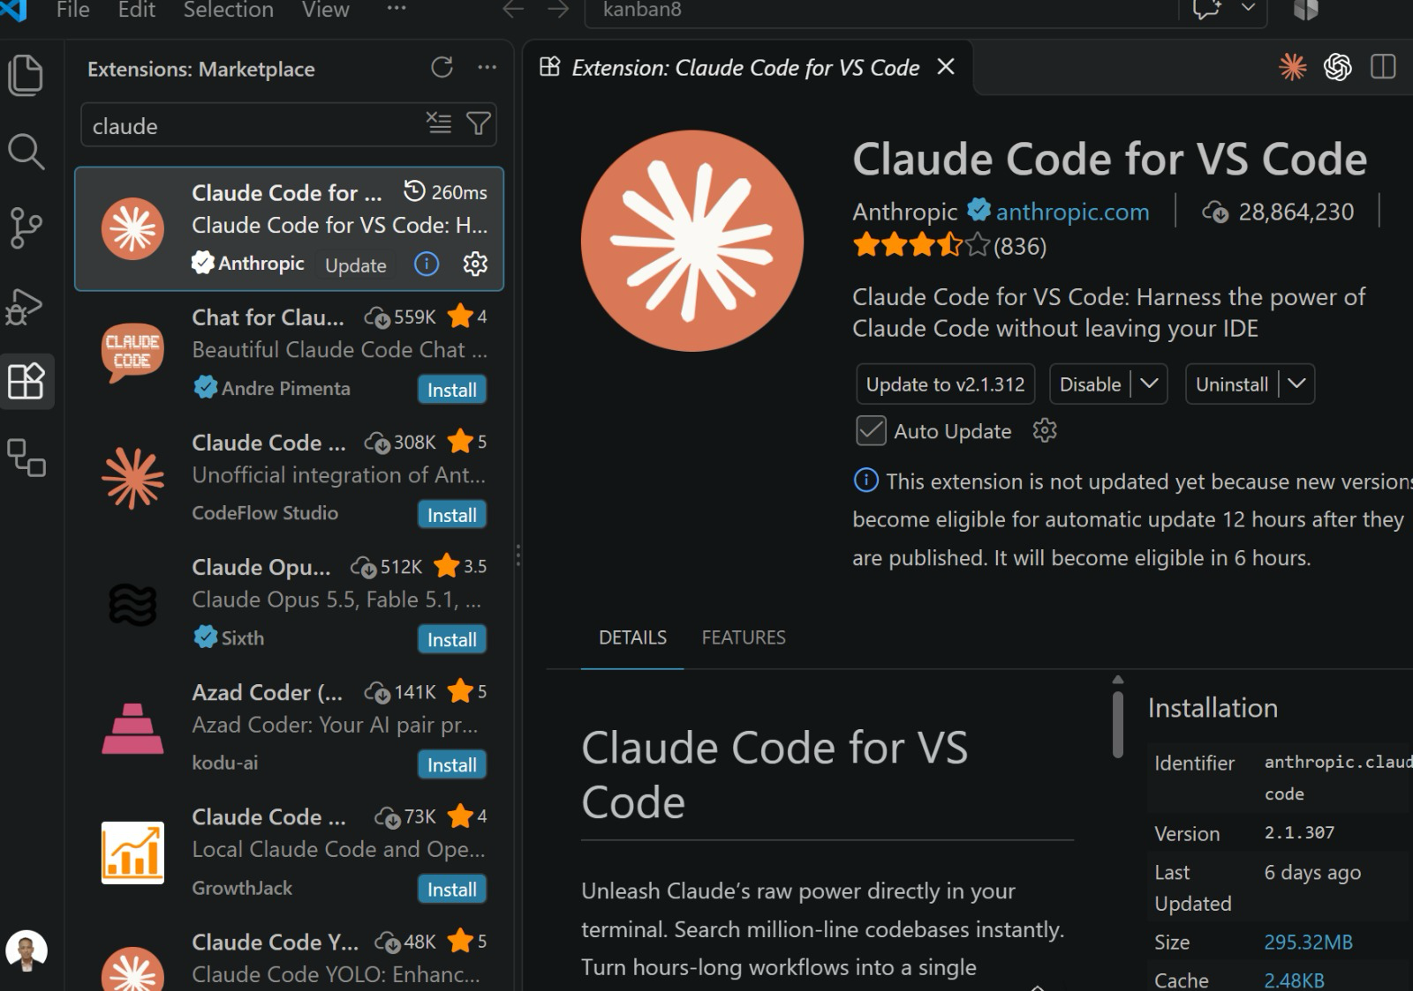
ACTIVITY 1 · GET SET UP
Install the Claude Code Extension
Before Step 1 — install the official Claude Code extension from the VS Code Marketplace.
1
Open Extensions
Click the Extensions icon or press Ctrl+Shift+X (Cmd+Shift+X on Mac).
2
4
2
Search “claude”
Type claude in the Marketplace search box.
3
1
Pick “Claude Code for VS Code”
Select the result published by Anthropic.
5
3
4
Check the publisher
Look for the blue verified tick and anthropic.com — skip look-alike extensions.
5
Install & keep it updated
Click Install and leave Auto Update ticked to get new features.
TIP An extension can read your whole codebase — install only the verified Anthropic one.
© Tertiary Infotech Academy Pte Ltd
Agentic AI Applications with Claude Code
29

Slide 30
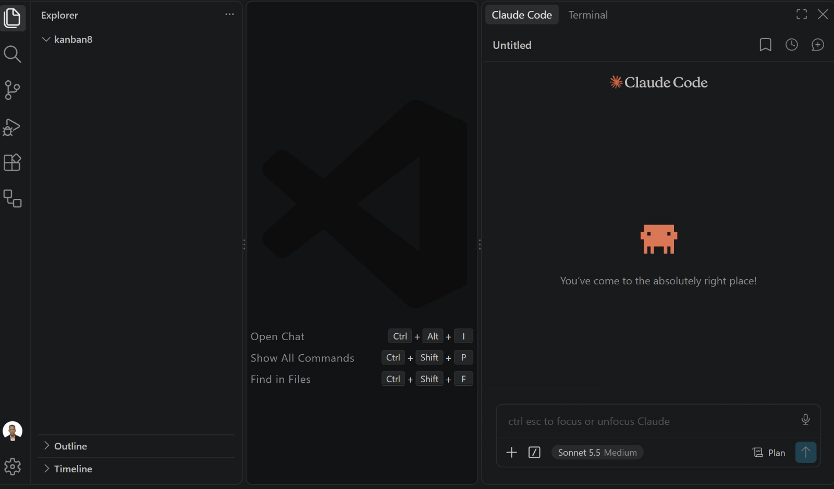
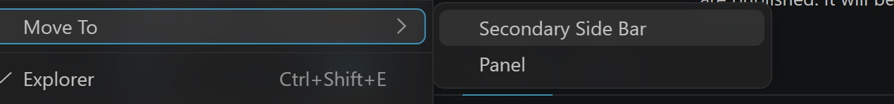
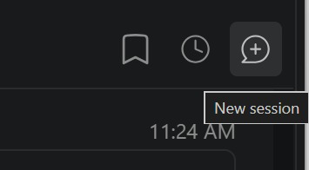
ACTIVITY 1 · GET SET UP
Move Claude Code to the Secondary Side Bar
Next, dock Claude Code on the right, so files stay on the left and the editor stays in the middle.
1
Right-click the Claude icon
Move To → Secondary Side Bar
2
4
2
Files on the left
Explorer shows your project folder (kanban8).
3
3
Claude Code on the right
Chat with Claude while files change in the editor.
4
New session
+ starts fresh; the clock reopens history.
5
5
Prompt box
Ctrl+Esc to focus · / for commands · pick Plan & model.
© Tertiary Infotech Academy Pte Ltd
Agentic AI Applications with Claude Code
30

Slide 31
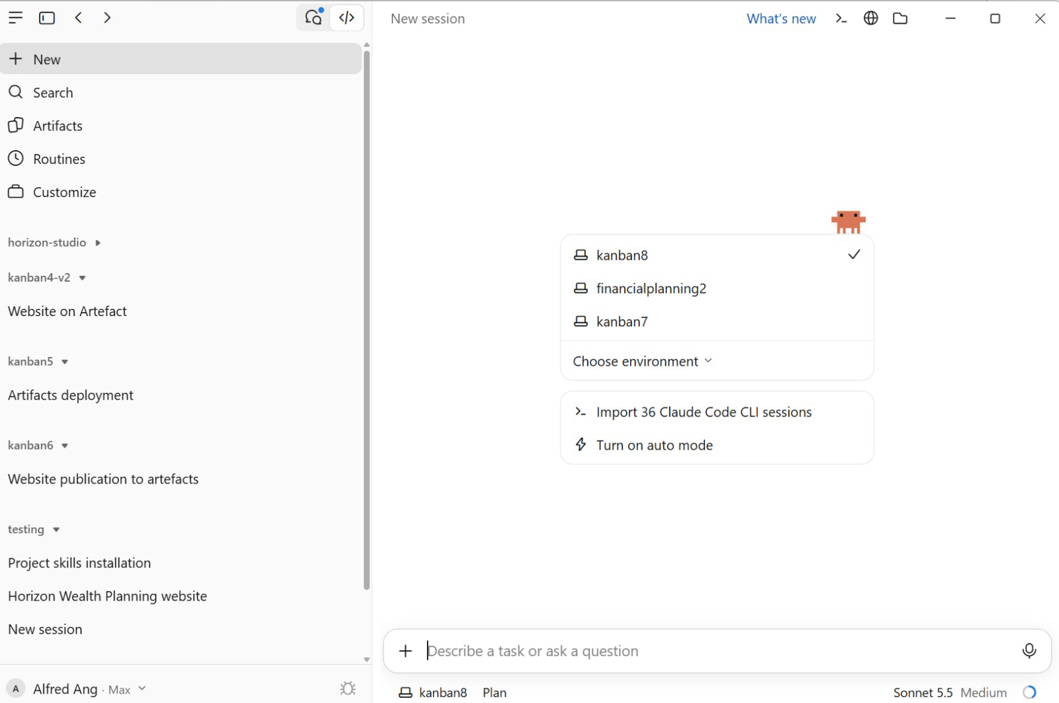
ACTIVITY 1 · GET SET UP
Or Use Claude Code in the Desktop App
Prefer a GUI? The Claude Desktop app runs the same Claude Code agent — open the Code tab and point it at a project folder.
1
1
Open the Code tab
Click the </> icon at the top-left to switch from Chat to Claude Code.
2
Choose your project folder
Pick a folder (here kanban8). Claude reads and edits files only inside it.
5
2
3
Describe the task
Type your goal in plain English and press Enter — the same agentic loop as the CLI.
4
Check folder, mode & model
The status bar shows the folder, permission mode (Plan) and model (Sonnet 5.5 · Medium).
5
Sessions grouped by project
The sidebar lists past sessions under each project — click one to resume.
3
4
TIP “Import Claude Code CLI sessions” brings your terminal history into the Desktop app.
© Tertiary Infotech Academy Pte Ltd
Agentic AI Applications with Claude Code
31

Slide 32
STEP 1 · GOAL & FEATURES
Start With a Clear Prompt
Describe the goal & features
The clearer the brief, the better the build.
Use ChatGPT to draft it
Ask ChatGPT to expand your idea into a detailed prompt, then paste it into Claude Code.
Cover the essentials
Goal · sections · behaviour · styling · deliverable.
Example prompt (software-dev website)
Build a single-page, responsive website
for a software development company
(HTML, CSS, vanilla JS — no frameworks).
Goal: market services + capture leads.
Sections: 1) Hero + CTA 2) 3 testimonial
cards 3) Enquiry form (JS validation,
console.log, commented fetch()).
Styling: mobile-first, CSS variables,
Google Font, smooth scroll, accessible.
Deliverable: runs by opening the file.
TIP The full prompt is in your Learner Guide (Activity 1).
© Tertiary Infotech Academy Pte Ltd
Agentic AI Applications with Claude Code
32

Slide 33



TOPIC 1 · PERMISSIONS
Permission Modes
Permission modes control how often Claude pauses to ask before editing files or running commands.
default
acceptEdits
plan
auto
Reads freely; asks before edits and shell commands.
Auto-approves file edits and common filesystem commands.
Explores and proposes a plan without editing source.
Runs with background safety checks (research preview).
TIP Press Shift+Tab to cycle modes; the current mode shows in the status bar.
© Tertiary Infotech Academy Pte Ltd
Agentic AI Applications with Claude Code
33

Slide 34

TOPIC 1 · PERMISSIONS
Bypass Permissions — Handle with Care
bypassPermissions / --dangerously-skip-permissions
Skips all permission prompts and safety checks — tool calls run immediately.
Offers NO protection against prompt injection or unintended actions.
Use only in isolated containers / VMs without internet access.
Refuses to start as root/sudo; cannot be entered mid-session.
Prefer auto mode for fewer prompts WITH background safety checks.
© Tertiary Infotech Academy Pte Ltd
34

Slide 35
STEP 3 · EXECUTE
Bypass Permissions in VS Code
To let Claude build hands-free, enable bypass-permissions mode — use it only in a trusted, sandboxed project.
1. Open VS Code Settings → Extensions → Claude Code.
2. Enable “Allow dangerously skip permissions”.
3. In the prompt box, open the mode selector.
4. Choose “Bypass permissions”.
5. Give your build prompt — Claude runs without per-action prompts.
CLI equivalent
$ claude \
--dangerously-skip-permissions
⚠ No safety checks or prompt-injection protection. Sandboxed / trusted projects only — prefer auto mode otherwise.
© Tertiary Infotech Academy Pte Ltd
Agentic AI Applications with Claude Code
35

Slide 36
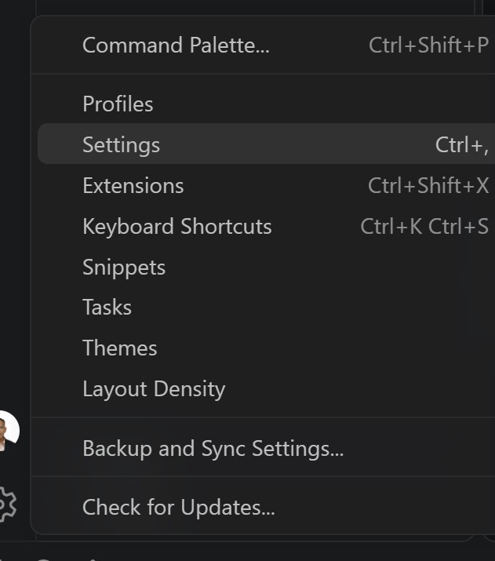
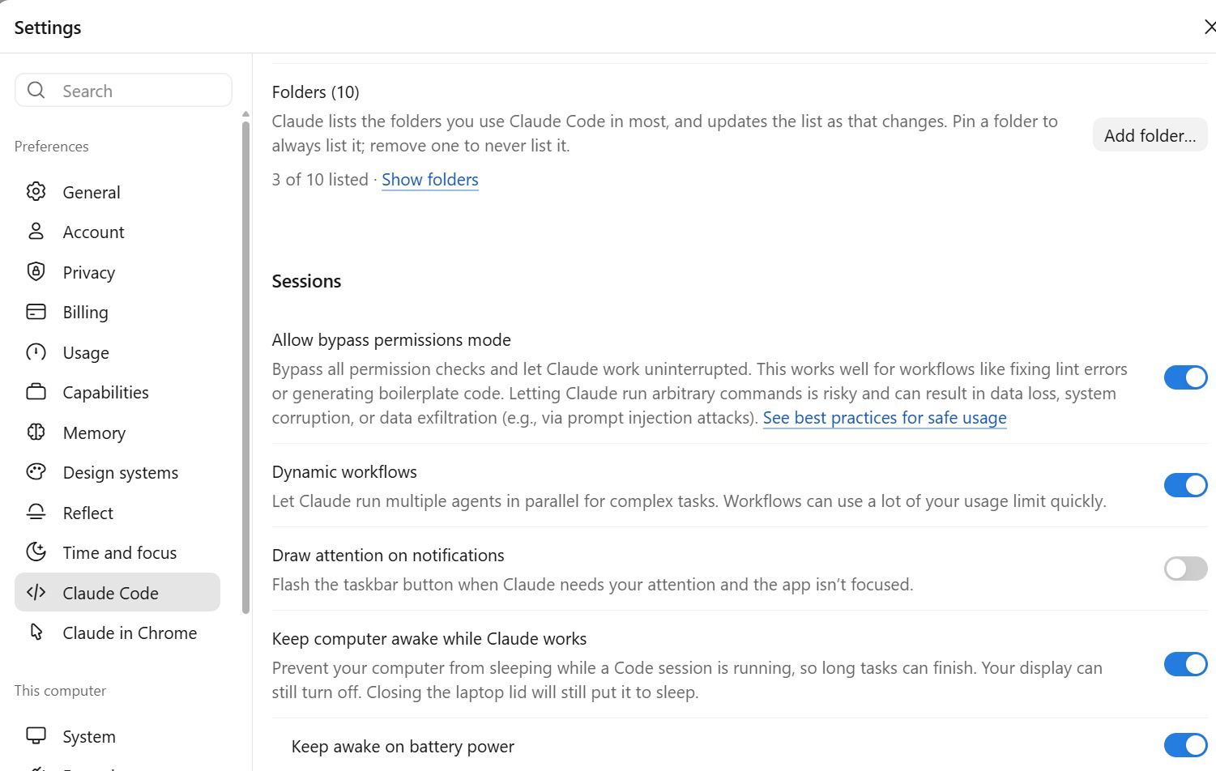
STEP 3 · EXECUTE
Allow Bypass Permissions — VS Code & Desktop
Both apps hide Bypass mode until you allow it in Settings. Turn it on only for trusted, sandboxed projects.
VS CODE
CLAUDE DESKTOP
1
Gear icon
Bottom-left of VS Code.
2
Settings
Or press Ctrl+, (Cmd+, on Mac).
2
2
3
Search “Claude Code”
Tick “Allow dangerously skip permissions”.
4
Pick the mode
Prompt box mode menu → Bypass permissions.
1
3
1
⚠ No safety checks or prompt-injection protection — sandbox only.
1 Settings → Claude Code 2 Allow bypass mode 3 Keep awake (optional)
© Tertiary Infotech Academy Pte Ltd
Agentic AI Applications with Claude Code
36

Slide 37

ACTIVITY 1A
Goal, Plan & Build (Steps 1–3)
1
Step 1 — Goal & Features: draft a detailed build prompt (use ChatGPT) for the software-dev website.
2
Step 2 — Plan Mode: have Claude plan the build (Shift+Tab) and review the plan.
3
Step 3 — Execute: approve the plan and build the site in Bypass Permissions mode.
4
Open index.html and check the hero, testimonials and enquiry form work.
TIP Full website prompt is in your Learner Guide (Activity 1).
© Tertiary Infotech Academy Pte Ltd
37

Slide 38



TOPIC 1 · CONTEXT ENGINEERING
Context Engineering
Context engineering is the practice of curating exactly what Claude sees — instructions, files and tools — so it has the right information and nothing that wastes its limited context window.
CLAUDE.md
@ mentions
/compact
/clear
Project memory loaded every session. Run /init to generate it.
Pull specific files or folders into context on demand.
Summarise the conversation to reclaim context space.
Wipe the slate for a fresh, unrelated task.
© Tertiary Infotech Academy Pte Ltd
Agentic AI Applications with Claude Code
38

Slide 39
TOPIC 1 · CONTEXT ENGINEERING
Managing Your Context
Keep CLAUDE.md tight
Project overview, conventions, commands to run. Short and high-signal.
Pull only what's needed
Use @file mentions instead of pasting whole folders.
Compact before it overflows
Watch the context meter; /compact at natural breakpoints.
Clear between tasks
Start fresh so old context doesn't bleed into new work.
CLAUDE.md
# My Web App
## Stack
Vanilla HTML, CSS, JS. No frameworks.
## Conventions
- Single index.html, mobile-first
- Use CSS variables for colors
## Commands
- Deploy: push to main (GH Pages)
© Tertiary Infotech Academy Pte Ltd
Agentic AI Applications with Claude Code
39

Slide 40
STEP 4 · CONTEXT ENGINEERING
Example CLAUDE.md (/init)
Run /init to generate a CLAUDE.md so Claude remembers your project's structure and conventions every session.
CLAUDE.md
# CLAUDE.md
## What this is
Single-page marketing site. HTML + CSS + vanilla JS — no framework, no build step.
## Running
Open index.html directly in a browser. No dev server.
## Architecture
- index.html — sections: #home, #services, #testimonials, #contact
- styles.css — design tokens in :root variables; mobile-first
- script.js — enquiry-form validation (one DOMContentLoaded handler)
TIP Keep CLAUDE.md short and high-signal — see github.com/alfredang/softwaredevleopment.
© Tertiary Infotech Academy Pte Ltd
Agentic AI Applications with Claude Code
40

Slide 41


TOPIC 1 · CONTEXT WINDOW
The Context Window
Claude's context window holds everything it can see at once. As you work it fills up, so manage it deliberately.
What fills it
/context
Auto-compaction
Stay lean
System prompt, CLAUDE.md, memory, conversation, file reads, tool output, skills.
See what's using space; run /mcp for per-server token cost.
Near the limit, old tool outputs clear first, then history is summarised.
MCP schemas load on demand; subagents keep their own context.
TIP Put persistent rules in CLAUDE.md — conversation detail can be lost during compaction.
© Tertiary Infotech Academy Pte Ltd
Agentic AI Applications with Claude Code
41

Slide 42

TOPIC 1 · MEMORY
Memory Files
Each session starts fresh. Two mechanisms carry knowledge across sessions.
CLAUDE.md
Auto Memory
You write it — instructions & rules.
Generate with /init; keep under ~200 lines.
Scopes: project, user, or organisation.
Loaded in full every session.
Claude writes it — learnings & patterns.
Stored in MEMORY.md per repository.
First 200 lines / 25KB load each session.
Browse & edit with /memory.
© Tertiary Infotech Academy Pte Ltd
Agentic AI Applications with Claude Code
42

Slide 43



TOPIC 1 · SESSIONS
Manage Sessions
A session is a saved conversation tied to a project directory. Resume, branch, name and switch between them.
--continue
--resume
/rename
/branch
Resume the most recent session in this directory.
Open the session picker to browse and search.
Name a session so it's findable later.
Fork the conversation to try another approach.
TIP Sessions are saved locally; use /clear and /compact to manage context within one.
© Tertiary Infotech Academy Pte Ltd
Agentic AI Applications with Claude Code
43

Slide 44



TOPIC 1 · SCHEDULED TASKS
Scheduled Tasks
Scheduled tasks (Desktop Routines) start a new session automatically — for daily reviews, audits or briefings.
Create
Schedule
Runs locally
Manage
Routines → New routine → Local; set name & instructions.
Hourly, daily, weekdays or weekly — or describe it.
Fires while the app is open and your machine is awake.
Run now, pause, edit, and review run history.
TIP Just ask: “set up a daily code review that runs every morning at 9am.”
© Tertiary Infotech Academy Pte Ltd
Agentic AI Applications with Claude Code
44

Slide 45



TOPIC 1 · GOAL
Keep Working Toward a Goal
/goal sets a completion condition. After each turn a fast model checks it, and Claude keeps working until it's met.
/goal <cond>
/goal
/goal clear
How
Set a verifiable end state, e.g. “all tests pass”.
Check status: turns, tokens and the latest reason.
Remove an active goal before it's met.
A Haiku evaluator judges the condition each turn.
TIP Write conditions Claude can prove in the transcript — e.g. “npm test exits 0”.
© Tertiary Infotech Academy Pte Ltd
Agentic AI Applications with Claude Code
45

Slide 46

ACTIVITY 1B
Context, Deploy & CI/CD (Steps 4–7)
1
Step 4 — Context: run /init to generate CLAUDE.md for your project.
2
Step 5 — Commit to GitHub: create an empty repo on github.com, then have Claude push your code.
3
Step 6 — Deployment: deploy to GitHub Pages via GitHub Actions; add a README.
4
Step 7 — CI/CD: confirm each push automatically rebuilds and redeploys the site.
5
Present your live GitHub Pages link: https://<username>.github.io/software-dev-site/
TIP Share your deployed GitHub Pages URL with the class.
© Tertiary Infotech Academy Pte Ltd
46

Slide 47
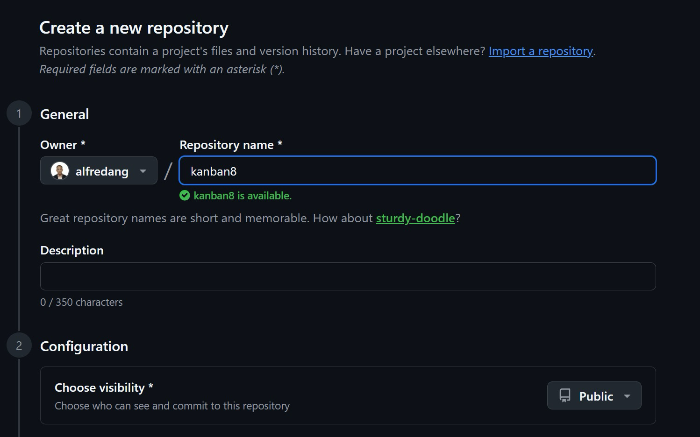
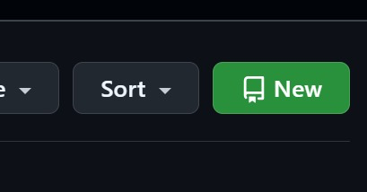
STEP 5 · COMMIT TO GITHUB
Create a GitHub Repository
Before Claude can push your code, create an empty repository on github.com to receive it.
1
Click New
github.com → Repositories → green New button.
3
2
2
Owner
Keep your own GitHub account.
4
3
Name the repository
e.g. software-dev-site — a green tick means it’s free.
4
Description (optional)
One line about the project.
TIP Use lowercase-with-hyphens — the repo name becomes part of your GitHub Pages URL.
© Tertiary Infotech Academy Pte Ltd
Agentic AI Applications with Claude Code
47

Slide 48
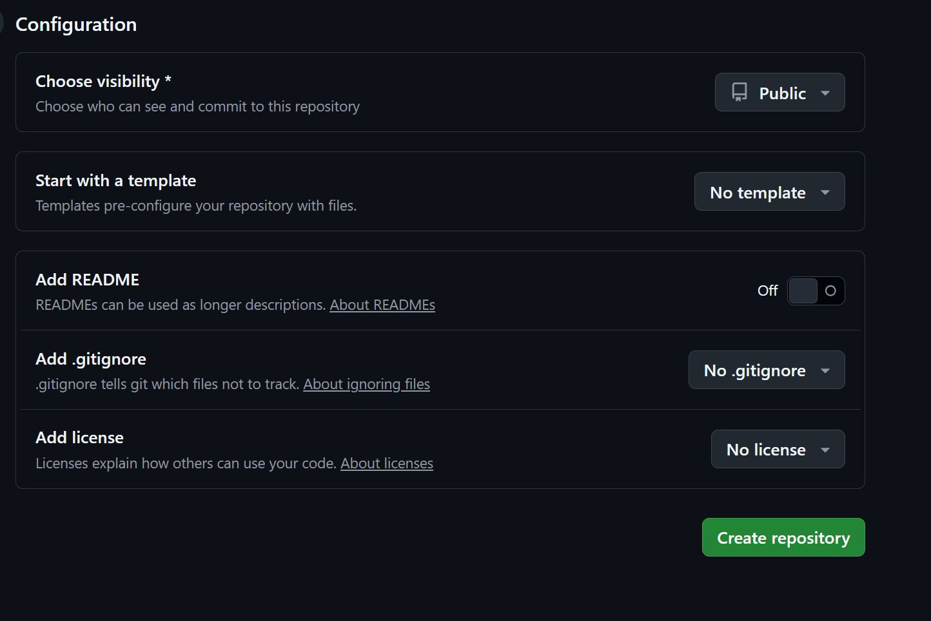
STEP 5 · COMMIT TO GITHUB
Configure & Create the Repository
Keep the repository empty — your project already has its files, and Claude will push them in the next step.
1
Visibility: Public
Free GitHub Pages hosting needs a public repository.
1
2
No template
Start from a blank repository.
2
3
README: Off
Leave it off — Claude writes the README in Step 6.
3
4
No .gitignore, no license
Files created here would clash with your first push.
4
5
Create repository
Click the green button to finish.
5
TIP An empty repo avoids the “rejected — fetch first” error on your first git push.
© Tertiary Infotech Academy Pte Ltd
Agentic AI Applications with Claude Code
48

Slide 49
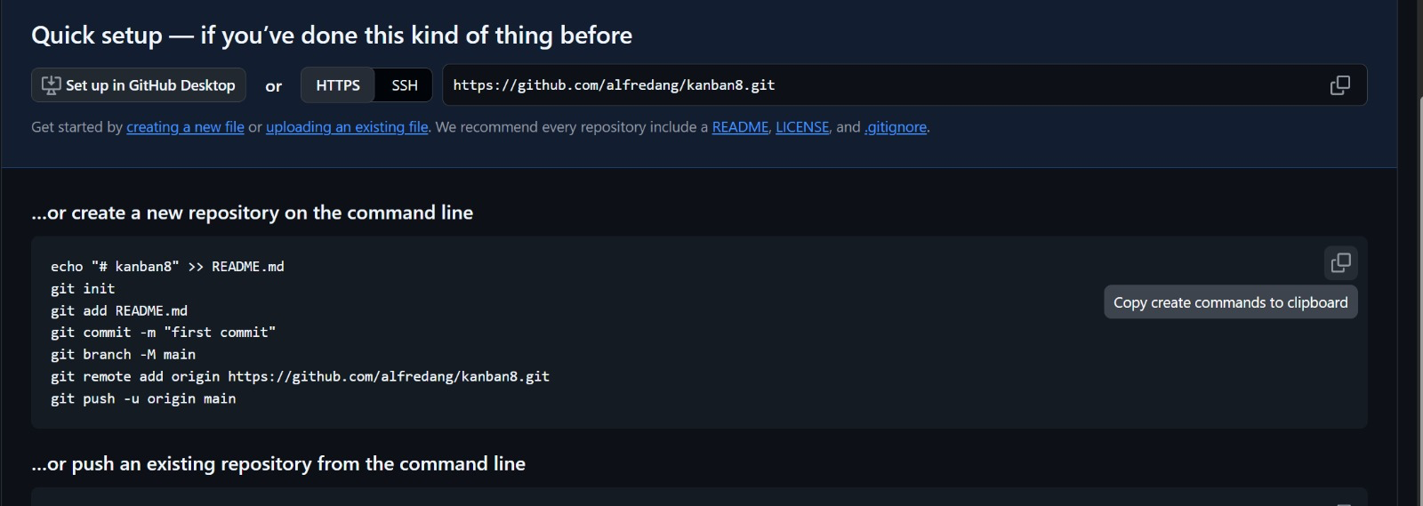
STEP 5 · COMMIT TO GITHUB
Connect & Push Your Code
GitHub shows your repository URL and the git commands — copy the URL and let Claude Code do the push.
1
1
Copy the HTTPS URL
Click the copy icon beside https://github.com/<you>/<repo>.git.
2
The git commands
init → add → commit → branch -M main → remote add → push.
3
Let Claude run them
Paste the prompt (left); Claude initialises git, commits and pushes.
2
4
Sign in when asked
Approve the GitHub sign-in (or run gh auth login) the first time.
Prompt to Claude Code
Commit all files and push this project to https://github.com/<username>/software-dev-site.git on the main branch.
5
Refresh the repo page
Your files appear — ready for Step 6, GitHub Pages.
© Tertiary Infotech Academy Pte Ltd
Agentic AI Applications with Claude Code
49

Slide 50
1
The .claude directory
TOPIC 2
2
Custom Commands
Tools and Commands
3
MCP Tools
4
Playwright MCP
© Tertiary Infotech Academy Pte Ltd
50

Slide 51
TOPIC 2 · CONFIGURATION
The .claude Directory
Claude Code keeps its configuration in two places: your user folder (applies everywhere) and the project folder (shared with your team via version control).
~/.claude/ (user — all projects)
<project>/.claude/ (team — in git)
settings.json # settings, hooks
CLAUDE.md # personal memory
agents/ skills/ commands/
projects/<p>/ # sessions + memory/
plugins/
~/.claude.json # MCP servers, config
settings.json # shared settings
settings.local.json # personal
CLAUDE.md rules/ # memory & rules
commands/ # /slash commands
skills/<name>/SKILL.md
agents/<name>.md # sub agents
.mcp.json # project MCP servers
TIP User scope applies to every project; project scope is committed so your whole team shares it.
© Tertiary Infotech Academy Pte Ltd
Agentic AI Applications with Claude Code
51

Slide 52
TOPIC 2 · CONFIGURATION
User Level vs Project Level
Every customisation — commands, MCP tools, skills, CLAUDE.md and hooks — can be stored at two levels. User level applies to ALL your projects; project level applies only to that ONE project.
User Level · ~/.claude/
Project Level · <project>/
APPLIES TO ALL PROJECTS
THIS PROJECT ONLY
Commands
~/.claude/commands/<name>.md
Commands
<project>/.claude/commands/<name>.md
MCP Tools
~/.claude.json · claude mcp add -s user …
MCP Tools
<project>/.mcp.json · claude mcp add -s project …
Skills
~/.claude/skills/<name>/SKILL.md
Skills
<project>/.claude/skills/<name>/SKILL.md
CLAUDE.md
~/.claude/CLAUDE.md (your personal memory)
CLAUDE.md
<project>/CLAUDE.md (shared with the team)
Hooks
~/.claude/settings.json → "hooks"
Hooks
<project>/.claude/settings.json → "hooks"
TIP Keep personal preferences at user level; commit team-shared rules, commands, skills and hooks at project level. Both levels load together — where they conflict, project settings take precedence.
© Tertiary Infotech Academy Pte Ltd
Agentic AI Applications with Claude Code
52

Slide 53
TOPIC 2 · CUSTOM COMMANDS
Custom Slash Commands
Custom commands are reusable prompts saved as Markdown files. Type a slash command to run a multi-step workflow the same way every time.
Where they live
.claude/commands/ in your project (or ~/.claude for personal).
How to make one
Create name.md — the filename becomes /name.
Reload
Restart Claude Code to pick up new commands.
Arguments
Use $ARGUMENTS to pass input into the command.
.claude/commands/gitpush.md
Push all code to GitHub, then:
1. Create a README
2. Enable GitHub Pages
3. Update repo About + Pages link
4. Scan for secrets before publishing
Target: $ARGUMENTS
© Tertiary Infotech Academy Pte Ltd
Agentic AI Applications with Claude Code
53

Slide 54

ACTIVITY 2
Create a /gitpush Command
1
Create .claude/commands/gitpush.md in your project.
2
Step: push/update all code to GitHub.
3
Step: generate a README for the repository.
4
Step: create a GitHub Page via GitHub Actions.
5
Step: update the repo About section and add the GitHub Pages link.
6
Step: security scan so no sensitive data is published.
TIP Restart Claude Code, then run /gitpush to execute the whole workflow.
© Tertiary Infotech Academy Pte Ltd
54

Slide 55




TOPIC 2 · MCP TOOLS
What is MCP?
The Model Context Protocol (MCP) is an open standard that lets Claude Code connect to external tools and data sources through a common interface — like a USB-C port for AI.
MCP Server
MCP Client
Transport
Tools
Exposes tools/data (e.g. Playwright, GitHub, databases).
Claude Code connects to servers and calls their tools.
stdio or HTTP/SSE — transport-agnostic communication.
Each server publishes callable actions Claude can use.
© Tertiary Infotech Academy Pte Ltd
Agentic AI Applications with Claude Code
55

Slide 56
TOPIC 2 · MCP TOOLS
Connect an MCP Server
Add a server
claude mcp add — register an HTTP or local stdio server.
Pick a scope
local (this project), project (.mcp.json, shared), or user (all projects).
Verify & use
claude mcp list to check status; /mcp to manage in-session.
terminal
# hosted server
$ claude mcp add --transport \
http docs <url>
# local stdio server (project)
$ claude mcp add playwright \
-s project -- npx -y \
@playwright/mcp@latest
$ claude mcp list
TIP Project-scoped servers live in .mcp.json — commit it so teammates get the same tools.
© Tertiary Infotech Academy Pte Ltd
Agentic AI Applications with Claude Code
56

Slide 57
TOPIC 2 · MCP TOOLS
Playwright MCP
The Playwright MCP server lets Claude Code drive a real browser — open pages, click, fill forms and capture screenshots — perfect for testing the website you just built.
Install at project level
Add the server to your project's MCP config.
Approve permissions
Allow Claude to launch and control the browser.
Use the tools
Ask Claude to open your site and take a screenshot.
terminal
$ claude mcp add playwright \
npx @playwright/mcp@latest
> open my site and take a
screenshot, then add it
to the README
© Tertiary Infotech Academy Pte Ltd
Agentic AI Applications with Claude Code
57

Slide 58

ACTIVITY 3
Install & Use Playwright MCP
1
Install the Playwright MCP tool at the project level.
2
Approve the browser permissions for Claude Code.
3
Ask Claude to open your deployed website in the browser.
4
Capture a screenshot of the site using the Playwright MCP tool.
5
Add the screenshot to your README and push to GitHub.
TIP Verify the screenshot renders correctly in your GitHub README.
© Tertiary Infotech Academy Pte Ltd
58

Slide 59

ACTIVITY 3B
Test the Enquiry Form (Playwright)
1
Wire the enquiry form to send submissions to angch@tertiaryinfotech.com (e.g. Formspree or a fetch to your endpoint).
2
Ask Claude to use the Playwright MCP tool to open your deployed site.
3
Fill the form with test data (name, email, message) and submit it.
4
Confirm the success message appears and the data is captured in the console.
5
Check that the enquiry email actually arrives in the inbox.
TIP Re-run after each change so every enquiry reliably reaches your email.
© Tertiary Infotech Academy Pte Ltd
59

Slide 60
1
Agent Skills
TOPIC 3
2
Sub Agents
Skills, Agents & Hooks
3
Hooks
4
Key Concepts Summary
© Tertiary Infotech Academy Pte Ltd
60

Slide 61

TOPIC 3 · AGENT SKILLS
Agent Skills
Skills are reusable folders of instructions (SKILL.md) plus optional scripts and resources that teach Claude how to do a specialised task. Claude loads a skill only when it's relevant.
SKILL.md
Project skills
Install
Customise
Name + description + instructions Claude follows on demand.
.claude/skills/ — shared with your repo & team.
npx skills add <repo> --skill <name>.
Edit the skill to fit your project's needs.
© Tertiary Infotech Academy Pte Ltd
Agentic AI Applications with Claude Code
61

Slide 62
TOPIC 3 · AGENT SKILLS
SKILL.md vs CLAUDE.md
Both are Markdown instruction files — the difference is WHEN Claude loads them.
SKILL.md
CLAUDE.md
Loaded ON DEMAND
Loaded EVERY SESSION
Trigger
Claude reads the name + description, and loads it only when the task matches.
Trigger
Read automatically at the start of every session — always in context.
Scope
One specialised capability — a workflow, a format, a house standard.
Scope
Project-wide facts: stack, conventions, commands, do-nots.
Cost
Costs no context until it fires; you can keep dozens installed.
Cost
Spends context on every turn, so keep it tight and high-value.
Lives in
.claude/skills/<name>/SKILL.md
Lives in
CLAUDE.md at the project root (or ~/.claude/CLAUDE.md)
TIP Put stable project facts in CLAUDE.md; put specialised, occasional procedures in a skill.
© Tertiary Infotech Academy Pte Ltd
Agentic AI Applications with Claude Code
62

Slide 63

ACTIVITY 4
Install & Run Skills
1
Install frontend-design: npx skills add https://github.com/anthropics/skills --skill frontend-design
2
Customise the frontend design to appeal to software-dev clients.
3
Install seo-audit: npx skills add https://github.com/coreyhaines31/marketingskills --skill seo-audit
4
Run the seo-audit skill to optimise the website's SEO.
5
Commit the improvements and push to GitHub.
TIP Both skills install into .claude/skills/ at the project level.
© Tertiary Infotech Academy Pte Ltd
63

Slide 64
TOPIC 3 · SUB AGENTS
Sub Agents
Sub agents are specialised assistants with their own prompt, tools and context window. Delegate focused jobs — like security review or UX critique — to keep the main thread clean.
Create with /agents
Choose Project to save under .claude/agents/.
Give it a clear role
Describe purpose, tools and when to invoke it.
Isolated context
Each sub agent runs in its own context window.
.claude/agents/security-scan.md
---
name: security-scan
description: Scan for vulns
& hardening
---
You are a security reviewer...
© Tertiary Infotech Academy Pte Ltd
Agentic AI Applications with Claude Code
64

Slide 65

TOPIC 3 · SUB AGENTS
Why Use Sub Agents?
Reach for a sub agent when a side task would flood your main conversation with output you won't reference again.
Preserve context
Enforce constraints
Reuse & specialise
Control costs
Exploration & logs stay in the agent's own window — only the summary returns.
Limit exactly which tools the sub agent is allowed to use.
Reuse configs across projects; focused prompts for each domain.
Route narrow tasks to a faster, cheaper model.
TIP Define a custom sub agent when you keep spawning the same kind of worker with the same instructions.
© Tertiary Infotech Academy Pte Ltd
Agentic AI Applications with Claude Code
65

Slide 66
TOPIC 3 · SUB AGENTS
Sub Agents vs Agent Teams
Sub Agents
Agent Teams
Main Agent
Main Agent (Team Lead)
spawn
spawn & assign tasks
Subagent
Subagent
Subagent
Shared Task List
work
claim tasks
Result
Result
Result
Teammate
Teammate
Teammate
report
communicate
work
work
work
Sub agents report back to one main agent · agent teams coordinate via a shared task list.
© Tertiary Infotech Academy Pte Ltd
66

Slide 67

ACTIVITY 5
Create Custom Sub Agents
1
Create a security-scan sub agent in .claude/agents/ to find vulnerabilities and harden the site.
2
Run it and apply the recommended fixes.
3
Install lead-magnets: npx skills add https://github.com/coreyhaines31/marketingskills --skill lead-magnets
4
Create a UI/UX review sub agent that uses lead-magnets to optimise for lead capture.
5
Apply improvements and push to GitHub.
TIP Both agents live in .claude/agents/ at the project level.
© Tertiary Infotech Academy Pte Ltd
67

Slide 68


TOPIC 3 · HOOKS
Hooks
Hooks are shell commands that run automatically at defined points in Claude Code's lifecycle — letting you enforce rules, format code, or trigger actions without asking.
PreToolUse
PostToolUse
Notification
Stop
Runs before a tool — validate or block an action.
Runs after a tool — auto-format or test.
React when Claude needs input or finishes.
Run cleanup or checks when a task ends.
Configured in .claude/settings.json under "hooks".
© Tertiary Infotech Academy Pte Ltd
Agentic AI Applications with Claude Code
68

Slide 69
TOPIC 3 · HOOKS
Automating with Hooks
Deterministic, not optional
Hooks always run at their event — they don't rely on the model deciding to.
Common uses
Auto-format after edits, run tests, block risky commands, send notifications.
Where
Add a "hooks" block to .claude/settings.json (matchers + commands).
.claude/settings.json
{
"hooks": {
"PostToolUse": [{
"matcher": "Edit|Write",
"hooks": [{
"type": "command",
"command":
"npx prettier --write ."
}]
}]
}
}
TIP Hooks receive event context on stdin as JSON — perfect for lint, format and guardrail scripts.
© Tertiary Infotech Academy Pte Ltd
Agentic AI Applications with Claude Code
69

Slide 70
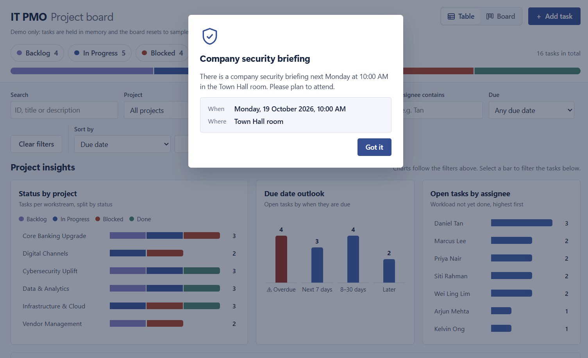
TOPIC 3 · HOOKS IN ACTION
Hook 1 · Pop-up After 10 Seconds
A timed page hook: stay on the page for 10 seconds and a dialog pops up with a key message — no click needed.
1
1
The 10-second pop-up
A timer starts on page load; after 10 s the dialog opens and the page behind is dimmed.
2
2
One clear message
Headline, a short sentence and the key facts (When / Where) at a glance.
3
3
Easy to dismiss
Got it closes the dialog and remembers it, so it shows once per visitor.
script.js — runs in the visitor's browser
setTimeout(() => {
if (!localStorage.getItem('briefingSeen'))
showBriefing(); // open the dialog
}, 10000); // 10 s after load
TIP Ask Claude Code for it in plain English — e.g. “show this announcement 10 seconds after the page loads, once per visitor.”
© Tertiary Infotech Academy Pte Ltd
Agentic AI Applications with Claude Code
70

Slide 71
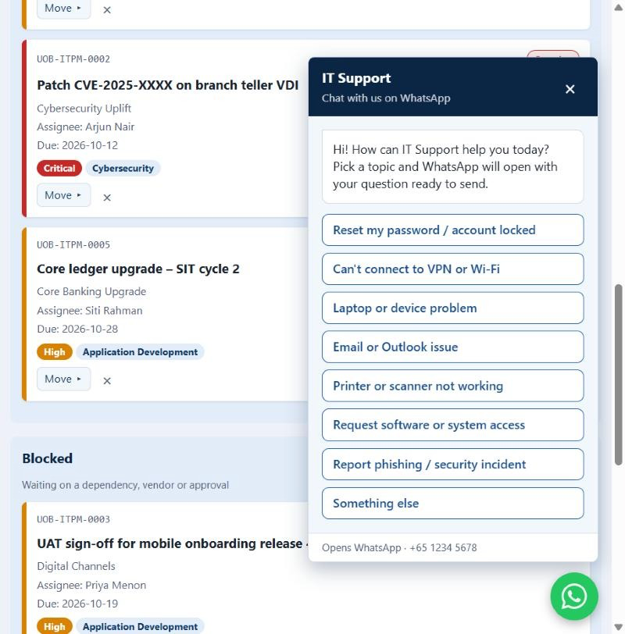
TOPIC 3 · HOOKS IN ACTION
Hook 2 · Voice Greeting on Chat Click
An event hook: click the chat icon and the assistant speaks a greeting, then offers one-tap topics that open WhatsApp.
1
Click the chat icon
The round WhatsApp button (bottom-right) is the trigger — the click event fires the hook.
2
Voice greeting + welcome
The assistant says “Hi, I am your assistant. How can I help you today?” as the panel opens.
2
3
Quick-reply topics
One-tap buttons for the most common questions — no typing needed.
4
Hand-off to WhatsApp
Picking a topic opens WhatsApp with the question ready to send.
3
script.js — Web Speech API (speech synthesis)
chatIcon.addEventListener('click', () => {
openPanel();
speechSynthesis.speak(new SpeechSynthesisUtterance(
'Hi, I am your assistant. How can I help you today?'));
});
4
1
TIP Browsers block sound until the visitor interacts — so the voice plays on click, not on page load.
© Tertiary Infotech Academy Pte Ltd
Agentic AI Applications with Claude Code
71

Slide 72

ACTIVITY 6
Hooks — Floating WhatsApp Widget
1
Add a floating WhatsApp widget to the bottom-right of the website from Activity 1.
2
Style it as a round WhatsApp button that expands into a chat panel on click.
3
Add a Claude Code hook that fires 10 seconds after page load to auto-open the widget.
4
On auto-open, prompt the user “Hi! How can I help you?” with suggested queries as quick-reply chips.
5
Add voice activation — let the visitor speak their question using the Web Speech API.
6
Use the Playwright MCP to test the 10-second auto-open, the suggested queries and the voice prompt.
TIP Hooks live in .claude/hooks + .claude/settings.json; the widget behaviour lives in script.js.
© Tertiary Infotech Academy Pte Ltd
72

Slide 73

ACTIVITY 7
Test, Optimise & Deploy
1
Use Playwright MCP to test the enquiry form end-to-end.
2
Ensure all enquiries are sent to angch@tertiaryinfotech.com.
3
Add a WhatsApp floating widget (bottom-right) with suggestive queries, linked to +65 9698 3731.
4
Run a final security scan and lead-magnet UX review.
5
Deploy the final version and verify the live site end-to-end.
TIP Record the live URL and the tests completed for your final verification.
© Tertiary Infotech Academy Pte Ltd
73

Slide 74
KEY CONCEPTS · SUMMARY
What Triggers What
Six ways to extend Claude Code — each one is loaded by a different trigger. Knowing which fires when is how you choose the right mechanism.
CLAUDE.md
Project memory — read automatically at the start of every session, so it is always in context.
EVERY SESSION
Skills
SKILL.md folders — Claude reads the name + description, and loads one when the task matches.
ON DEMAND
Tools / MCP
Built-in and MCP tools — invoked by Claude during the agentic loop whenever the job needs them.
ON DEMAND
Slash Commands
Saved prompts in .claude/commands/ — they run only when you type /<name> yourself.
MANUALLY
Hooks
Shell commands in settings.json — fired deterministically by a lifecycle event, not by the model.
BY EVENT
Sub Agents
Specialised assistants with their own context — spawned when the main agent delegates a job.
BY DELEGATION
TIP Always-on context is expensive — keep CLAUDE.md tight and push specialised, occasional procedures into skills, commands and sub agents.
© Tertiary Infotech Academy Pte Ltd
Agentic AI Applications with Claude Code
74

Slide 75
AI SECURITY
5 Principles of AI Security
Agents act on your behalf. These five controls keep what they can see and do safe, reviewable and accountable.
Data Control
Classify your data (public, internal, confidential) and decide exactly which data the AI may access.
WHAT AI CAN SEE
Permission Control
Grant only the rights needed — read, write, edit, delete. Ask before anything destructive.
WHAT AI CAN DO
Human in the Loop
A person reviews and approves high-impact actions — deploys, deletions, payments, emails.
WHO APPROVES
Traceability
Log every prompt, tool call and change so actions can be audited, explained and rolled back.
WHAT HAPPENED
Right-Sized Models
Do not use the most powerful models by default — the smallest model that does the job has less autonomy and risk.
NOT THE MOST POWERFUL
TIP In Claude Code: permission modes & allow/deny rules, hooks for guardrails & logs, plan mode for human review.
© Tertiary Infotech Academy Pte Ltd
Agentic AI Applications with Claude Code
75

Slide 76

WRAP UP
Summary & Q&A
Topic 1
The agentic loop and context engineering power everything Claude Code does.
Topic 2
Custom commands and MCP tools automate and extend your workflow.
Topic 3
Skills, sub agents and hooks make Claude a specialised teammate.
Integrated Build
You built, deployed, tested, secured and optimised a real website.
© Tertiary Infotech Academy Pte Ltd
Agentic AI Applications with Claude Code
76

Slide 77




ASSESSMENT
Assessment Flow
At the assessment stage, follow these five steps in order.
STEP 1
STEP 2
STEP 3
STEP 4
STEP 5
TRAQOM
Attendance
Assessment
Submit Answers
Sign the Record
Scan the TRAQOM QR code on the LMS and complete the survey.
Take the assessment digital attendance.
Complete the WA & PP.
Submit your assessment answers on the LMS.
Sign your Assessment Summary Record.
TIP Courseware and the assessment are on the LMS: https://lms-tms.tertiaryinfotech.com/
© Tertiary Infotech Academy Pte Ltd
Agentic AI Applications with Claude Code
77

Slide 78

BEFORE YOU GO
Certification & TRAQOM Survey
TRAQOM Survey (Mandatory)
Digital Attendance
Complete the certification & TRAQOM survey to receive your certificate.
ai-lms-tms.tertiaryinfo.tech
Remember to take AM, PM and Assessment digital attendance — required for your funding.
© Tertiary Infotech Academy Pte Ltd
Agentic AI Applications with Claude Code
78

Slide 79
Thank You!
Questions? We're here to help — during and after class.
enquiry@tertiaryinfotech.com | +65 6100 0613

